Slide 1
Gaussian Processes for treatment of model defects in nuclear data evaluations.
H. Sjöstrand, J. Hansson
Uppsala University
A large part of the presentation is based on work performed by G.Schnabel and P. Helgesson when they were active at Uppsala University

Slide 2
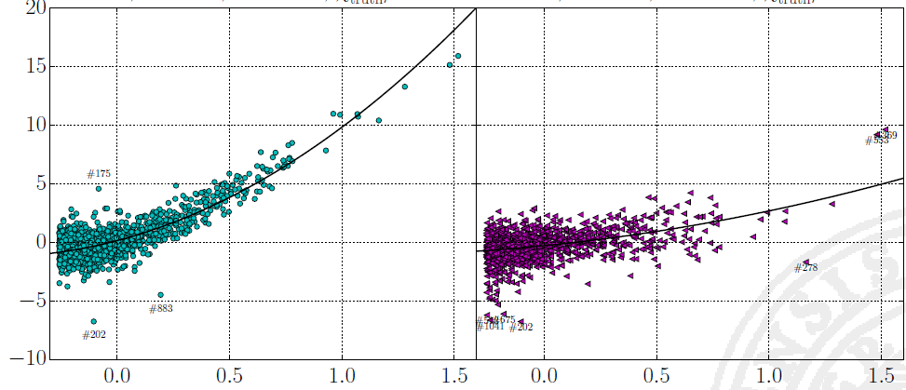
Evaluation results sensitive to model defects
Parameter domain (UMC - B)
Observable domain (GLS)
Error in evaluation
Magnitude of model defect
P. Helgesson et al., “Assessment of Novel Techniques for Nuclear Data Evaluation,” Reactor Dosimetry: 16th International Symposium, Nov. 2018, doi: 10.1520/STP160820170087
Plenty of evidence in literature that model defects deteriorate ND evaluations if not accounted for.
Notes:
Koning, Erik Bauge,

Slide 3
Can we treat model defects using Gaussian Processes?

Slide 4
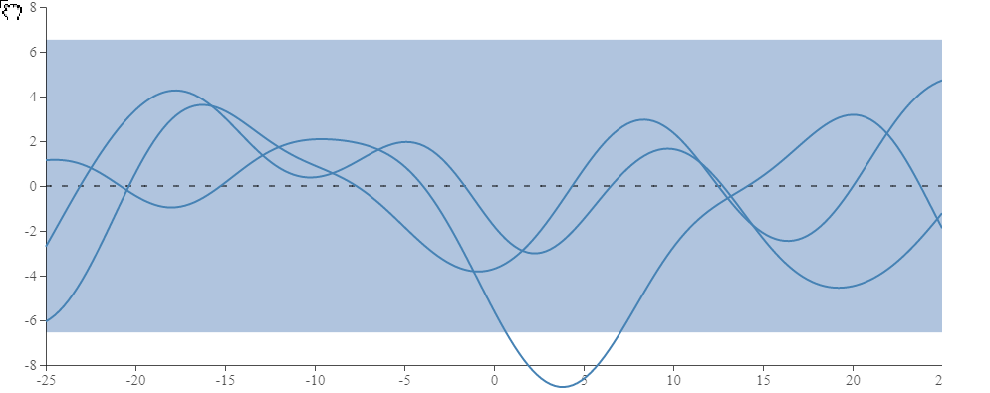
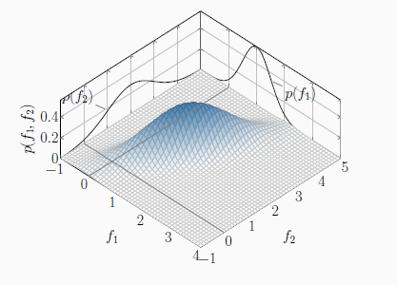
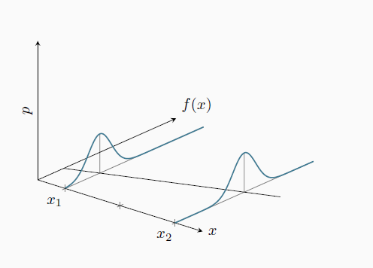
Gaussian Processes
λ
A
mean function
Cov(x,x’; A,λ)
C. E. Rasmussen and C. K. I. Williams, Gaussian processes for machine learning. Cambridge, Mass: MIT Press, 2006.

Slide 5
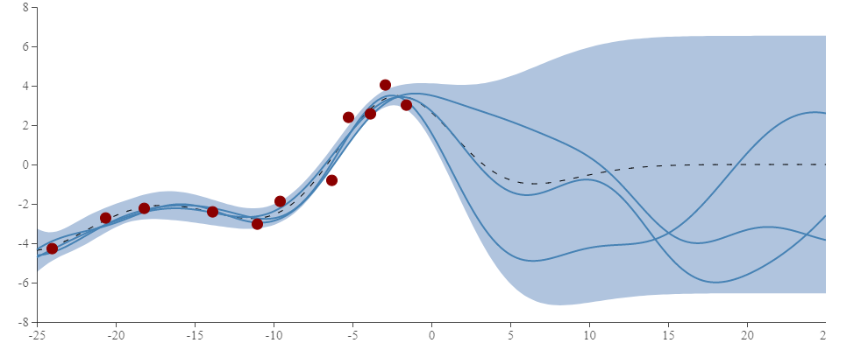
Treating model defects with GP
Standard treatment of model defect:
Prior
http://www.it.uu.se/edu/course/homepage/apml/GP/

Slide 6
Treating model defects with GP
Standard treatment of model defect:
λ
Prior
A

Slide 7
Hyper parameters
λ
A
Hyper parameters (A, λ) determined by
Marginal Likelihood Optimization
Cross validation

Slide 8
Solution 1: Treating model defects adding GP on the observable
New model:
Posterior
None parametric
Closed form solution
Flexibility in choice of covariance.
Account for data uncertainties

Slide 9
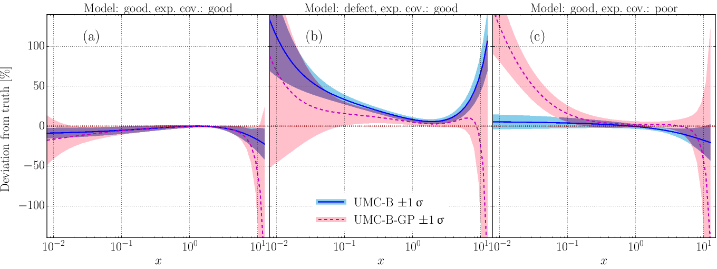
Results from PFNS synthetic data study
P. Helgesson et al., “Assessment of Novel Techniques for Nuclear Data Evaluation,” Reactor Dosimetry: 16th International Symposium, Nov. 2018, doi: 10.1520/STP160820170087. (GP wok done by M. Grosskopf)

Slide 10
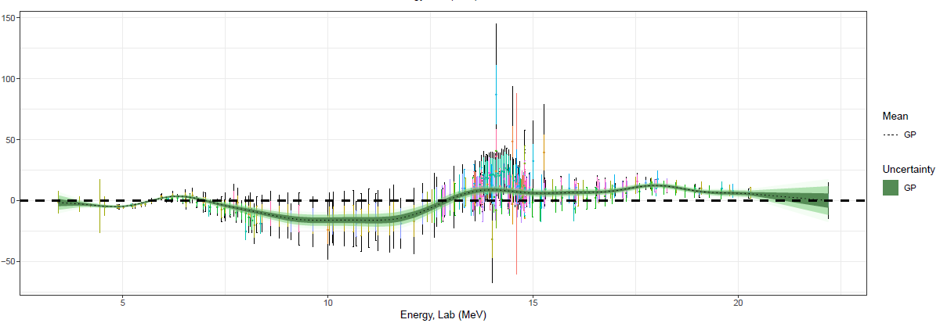
TALYS on (26−FE−56(N,P)25−MN−56
Residuals /ε_{m}
The model describes the data well

Slide 11
TALYS on (26−FE−56(N,P)25−MN−56
Residuals /ε_{m}
Hard to integrate in a full evaluation (sum rules)
Difficulties with constant hyperparameters (resonances)
G. Schnabel and H. Sjöstrand, “A first sketch: Construction of model defect priors inspired by dynamic time warping,” EPJ Web Conf., vol. 211, p. 07005, 2019, doi: 10.1051/epjconf/201921107005.

Slide 12
Problematic when bad exp - cov

Slide 13
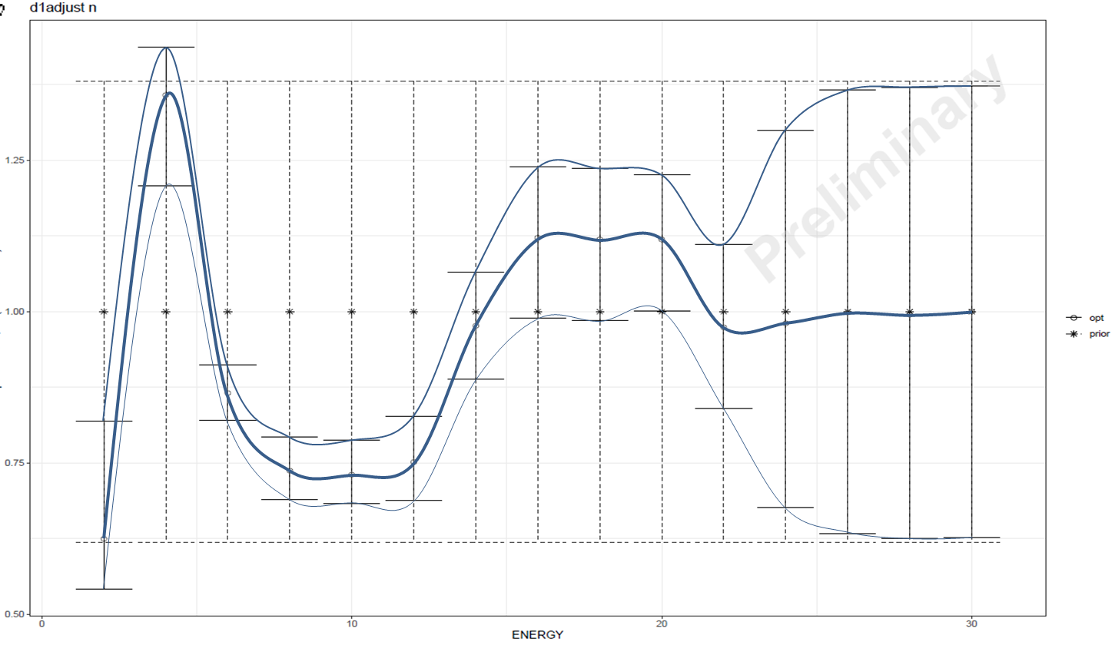

Solution 2:
GP in the parameter domain
Energy-dependent parameters^{1,2} around ‘global’ parameters β
The energy dependence modeled with GP
$$y_{j}=f\left(E_{j};{β}+δ(E_{j})\right)+ε;{ } δ_{i}(E)∼GP$$
At each E:
  Consistent physics
  Meaningful parameters
  Extrapolation to other isotopes?
[1] P. Helgesson and H. Sjöstrand, “Treating model defects by fitting smoothly varying model parameters: Energy dependence in nuclear data evaluation,” Annals of Nuclear Energy, vol. 120, pp. 35–47, Oct. 2018, doi: 10.1016/j.anucene.2018.05.026.
[2]G. Schnabel,et al., “Conception and software implementation of a nuclear data evaluation pipeline,” arXiv:2009.00521 [nucl-ex, physics:nucl-th, physics:physics], Sep. 2020, http://arxiv.org/abs/2009.00521.
Notes:
Normal: Model in the model space, Model defect in the observable space.

Slide 14

Observation
Posterior
The system gives flexibility to
  parameter best estimate
  parameter uncertainty
Data at a certain energy will not constrain the model at all energies.

Slide 15
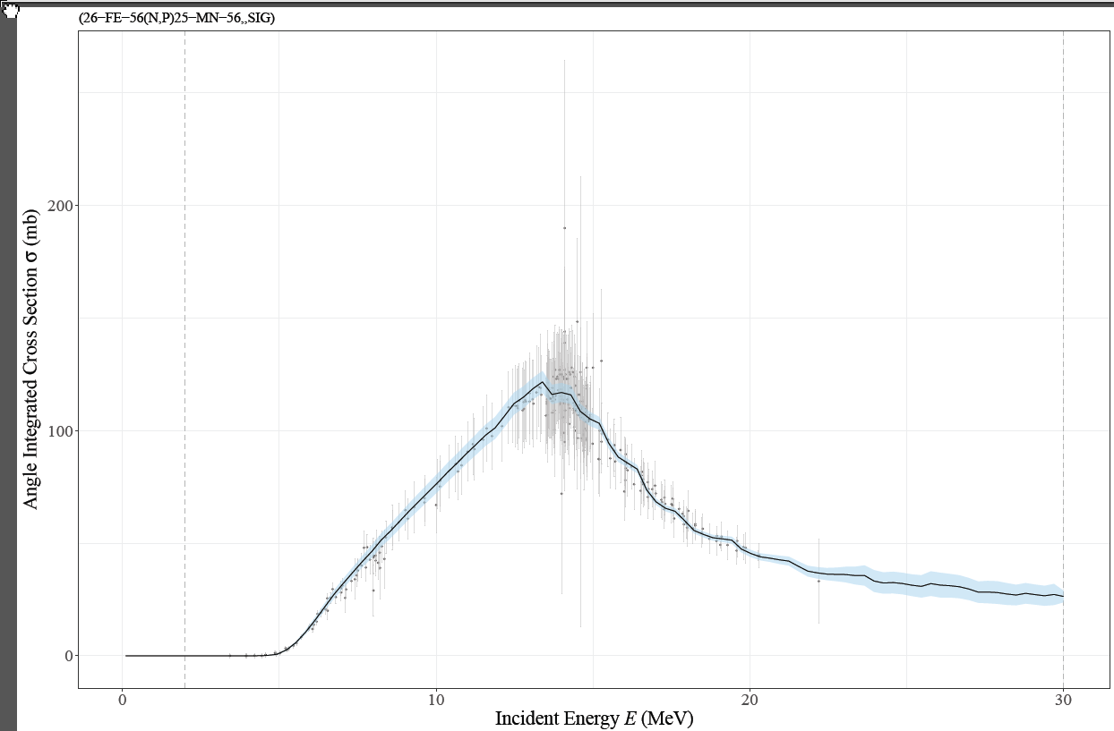
Reproduces data…
(26−FE−56(N,P)25−MN−56
but…

Slide 16
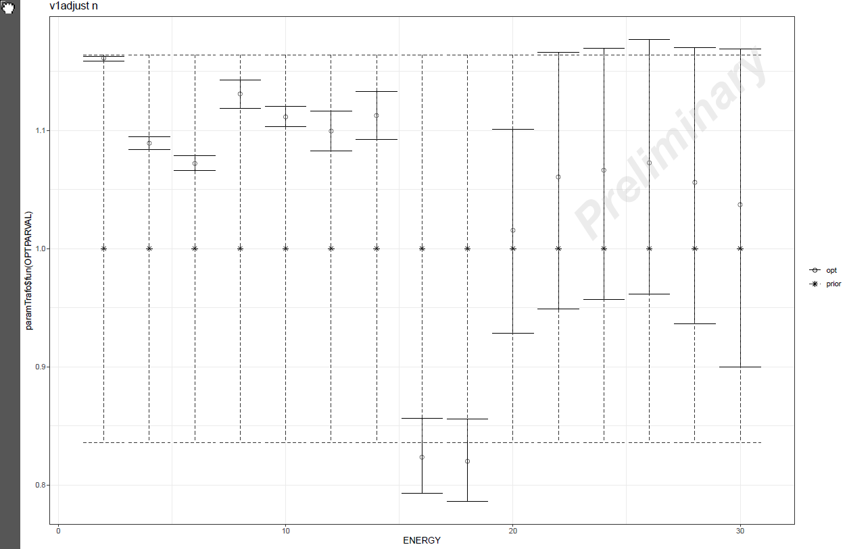
Parameter variations
Rapid variations in parameters
Possibly to small uncertainties

Slide 17
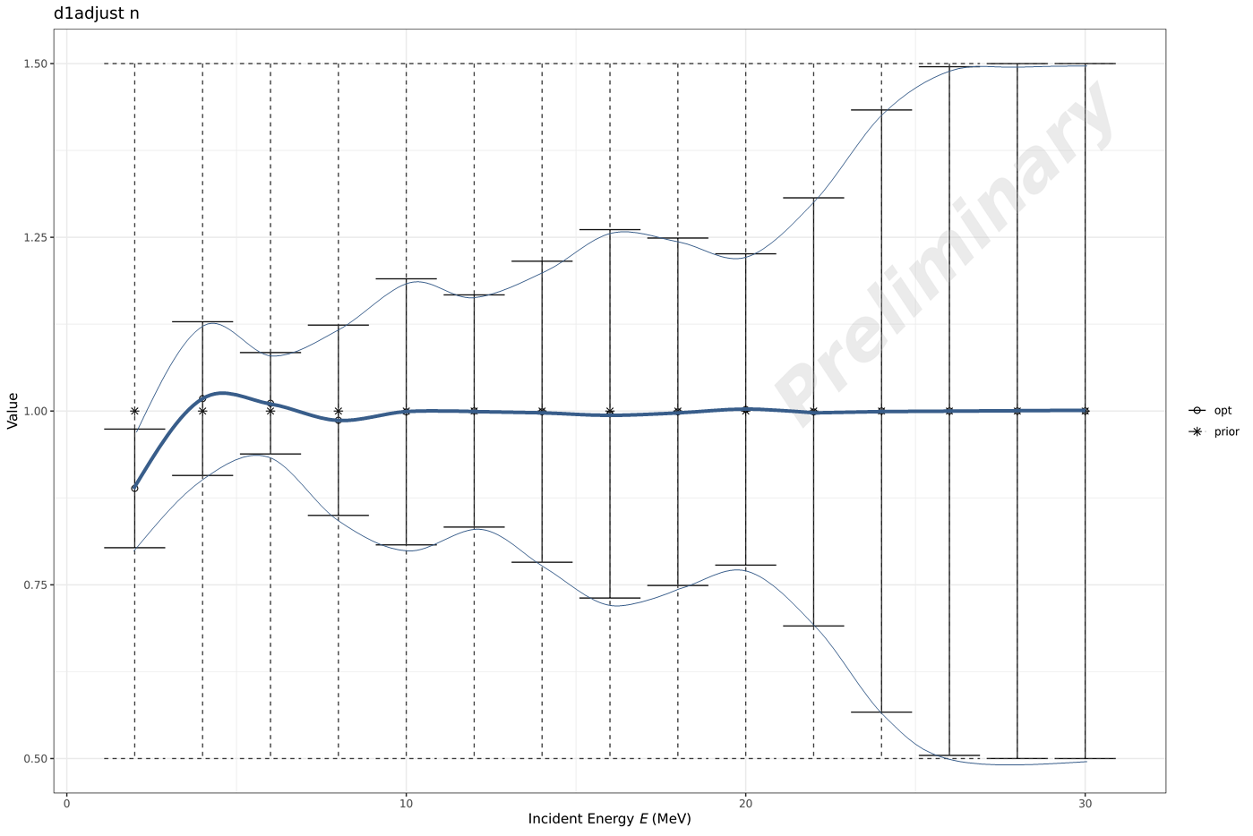
Solution 3: Combining the methods
prior
Note zero mean function

Slide 18
Observation 1
Adding also a GP on the observable side ‘favors’ the prior
  Mostly small updates of the prior
‘Smoother’ behavior

Slide 19
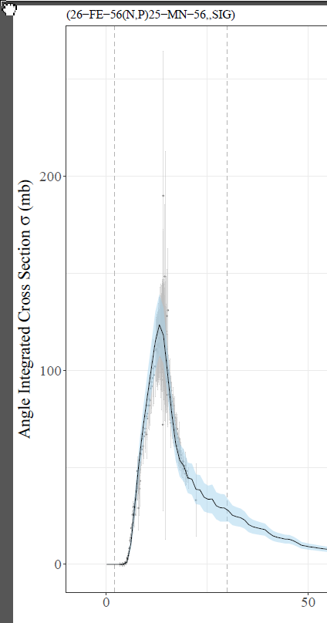
Observation 2
    Still reproduces data
(26−FE−56(N,P)25−MN−56

Slide 20
Conclusions
Model defects are a problem in nuclear data evaluation
GP can be used to treat model defects
  Adding GP on the observable
  GP in parameter domain
  GP parameter domain + GP prior on observable.
    Retains more of the model.
    Hypothesis: less sensitive to errors in exp. cov.
Thank you for your attention !

Slide 21
References
P. Helgesson and H. Sjöstrand, “Treating model defects by fitting smoothly varying model parameters: Energy dependence in nuclear data evaluation,” Annals of Nuclear Energy, vol. 120, pp. 35–47, Oct. 2018, doi: 10.1016/j.anucene.2018.05.026.
C. E. Rasmussen and C. K. I. Williams, Gaussian processes for machine learning. Cambridge, Mass: MIT Press, 2006.
P. Helgesson et al., “Assessment of Novel Techniques for Nuclear Data Evaluation,” Reactor Dosimetry: 16th International Symposium, Nov. 2018, doi: 10.1520/STP160820170087.
G. Schnabel, et al., “Conception and software implementation of a nuclear data evaluation pipeline,” arXiv:2009.00521 [nucl-ex, physics:nucl-th, physics:physics], Sep. 2020, http://arxiv.org/abs/2009.00521
G. Schnabel and H. Sjöstrand, “A first sketch: Construction of model defect priors inspired by dynamic time warping,” EPJ Web Conf., vol. 211, p. 07005, 2019, doi: 10.1051/epjconf/201921107005.
G. Schnabel, “Large Scale Bayesian Nuclear Data Evaluation with Consistent Model Defects,” Ph.D, TUW, 2015. Supervisor .H.Leeb.

Slide 22
Extra

Slide 23
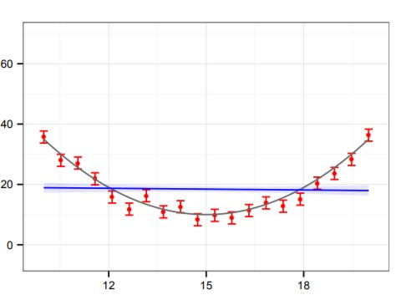
Model defects
Model defects = the model cannot reproduce the reality
The bias will supersede the estimated uncertainty
Measurements
Physical reality
Linear model + uncertainties (95 %)
The idea and part of the figure is adapted from Georg Schnabel, “Large Scale Bayesian Nuclear Data Evaluation with Consistent Model Defects,” Ph.D, TUW, 2015. Supervisor .H.Leeb.
Notes:
model defects = the model for the underlying physics does not exactly reproduce reality, no matter what parameters are chosen for the model. I.e., when fitting a defect model to data, the results can become very misleading by introducing a bias which supersedes the estimated uncertainty
Note the very small uncertainty band obtained with normal regression! What consequences would this have if safety margins were based on this model?

Slide 24
Treatment: Uncertainty inflation
The best estimated of the model is kept but the uncertainty is inflated.
Inflated uncertainty
Notes:
To some extent this is what is used in the TENDL

Slide 25
Treatment 2: Prediction / model correction
The model defect is estimated and corrected for
Model +model defect describe the the experimental observations.
Model + model defect
Notes:
The model+ model defect can reproduce the data well, retain smoothness and produces reasonable uncertainties. In regions, where there is no data the uncertainties increases. Gaussian Process can be used to model model-defects with these characteristics.

Slide 26
On computational
Vanilla gaussian processes scale poorly with data O(n^3)
Solutions: Data reduction or approximate model
Approximate model:
- m pseudo inputs z
- evaluate k(z,z')
- linear interpolation to data points
Integrates smoothly and takes full advantage of existing pipeline software
Linear mapping matrices are sparse, ie. fast computations
Care has to be taken to choose z such that features of the data are captured by the grid, ie. not too sparse

Slide 27
